Slide 1

C4_ Project_Logistics Optimization for Delivery Routes_UPS
Praveen Sai Lingala

Slide 2


Task 1: Data Cleaning & Preparation
Identify and delete duplicate Order_ID records.
There is No Duplcates found in Order_id from Orders Table
Output for no duplicates

Slide 3


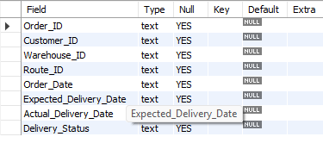
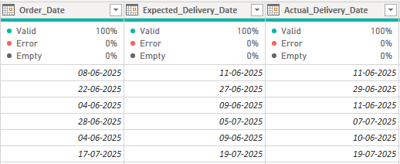
2. Replace null Traffic_Delay_Min with the average delay for that route.
Output for Null
No NULL values were found in the Traffic_Delay_Min column. Therefore, no replacement was required.
3. Convert all date columns into YYYY-MM-DD format using SQL functions

Slide 4
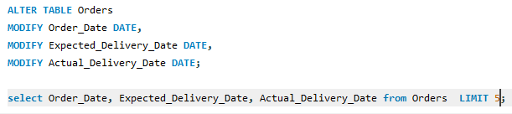
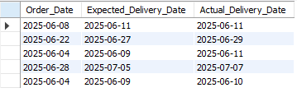


3. Convert all date columns into YYYY-MM-DD format using SQL functions.
Output
4.Ensure that no Actual_Delivery_Date is before Order_Date
Actual_Delivery_Date is not earlier than Order_Date
Output

Slide 5

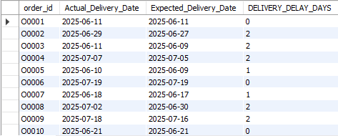
Task 2: Calculate delivery delay (in days) for each order
1. Calculate delivery delay (in days) for each order
Output

Slide 6
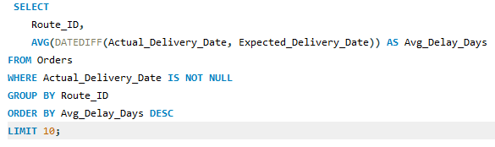
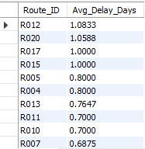
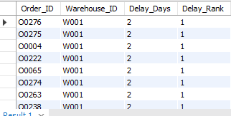
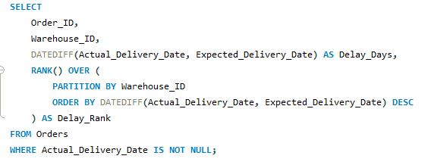
2. Find Top 10 delayed routes based on average delay days
3. Use window functions to rank all orders by delay within each warehouse

Slide 7
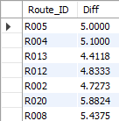

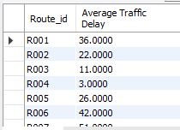

Task 3: Route Optimization Insights
Average delivery time (in days)
Average traffic delay

Slide 8
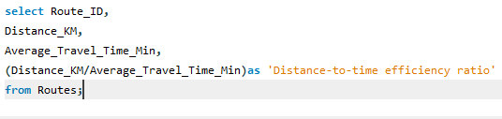
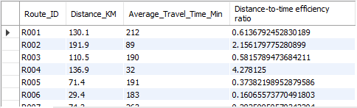
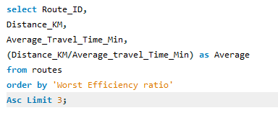

Distance-to-time efficiency ratio: Distance_KM / Average_Travel_Time_Min.
Identify 3 routes with the worst efficiency ratio

Slide 9
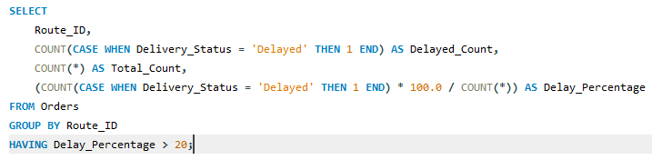
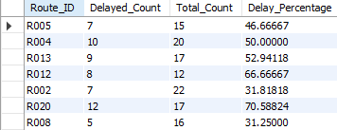
Routes with >20% Delayed Shipments

Slide 10
Recommend potential routes for optimization.
We should give priority to routes that are showing weak efficiency and have more than 20% of shipments running late. These routes are struggling with poor distance-to-time performance and repeated delivery delays. To address this, we can take practical steps such as:
Adjusting routes dynamically when conditions change
Scheduling dispatches with traffic patterns in mind
Assigning experienced drivers to challenging areas
Streamlining warehouse operations to cut down processing time
By focusing on these improvements, we’ll strengthen reliability and ensure deliveries reach customers on time

Slide 11
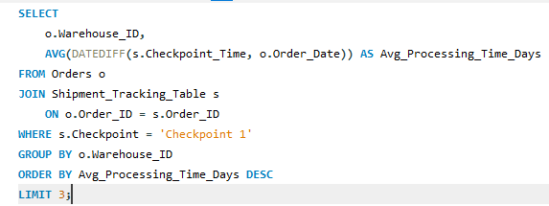

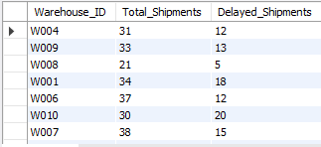
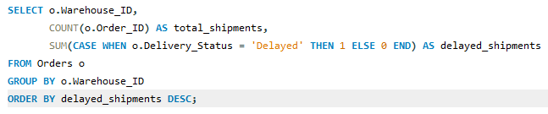
Task 4: Warehouse Performance
Find the top 3 warehouses with the highest average processing time
Calculate total vs. delayed shipments for each warehouse.

Slide 12
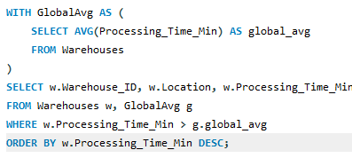
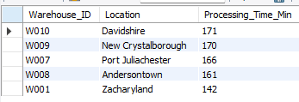
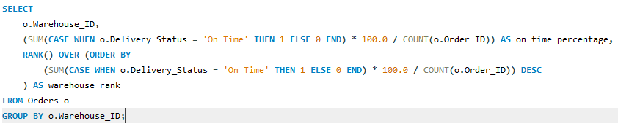
Use CTEs to find bottleneck warehouses where processing time > global average.
Rank warehouses based on on-time delivery percentage.

Slide 13
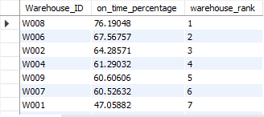

Slide 14
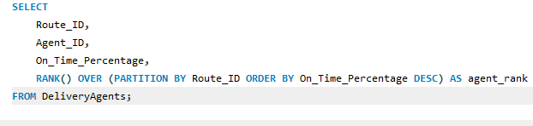
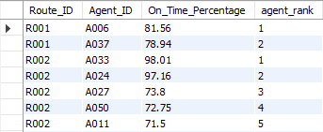
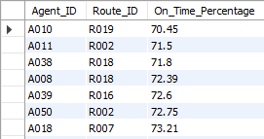

Task 5: Delivery Agent Performance
-- Rank agents (per route) by on-time delivery percentage--
Find agents with on-time % < 80%

Slide 15

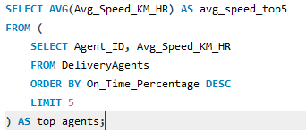

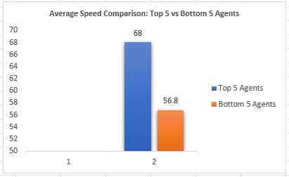
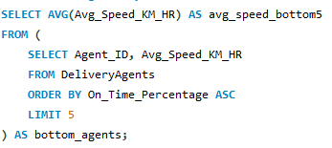
Compare average speed of top 5 vs bottom 5 agents using subqueries
top 5
Bottom 5

Slide 16
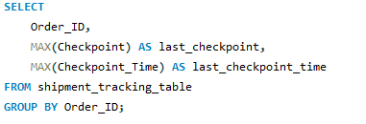
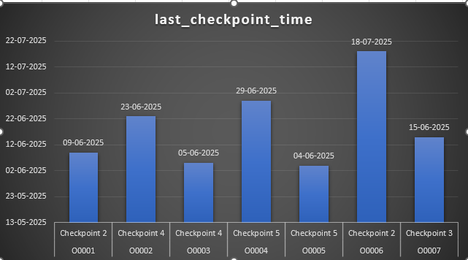
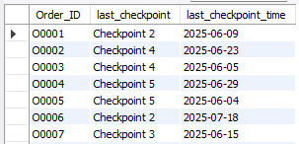
Task 6: Shipment Tracking Analytics
-- -- For each order, list the last checkpoint and time-- -

Slide 17
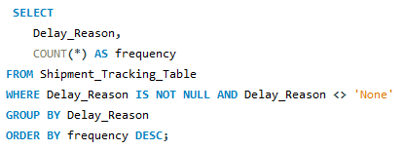

-- Find the most common delay reasons (excluding None) --

Slide 18
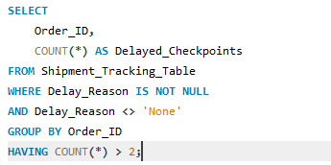
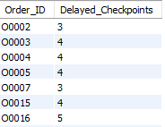
-- Identify orders with >2 delayed checkpoints--

Slide 19
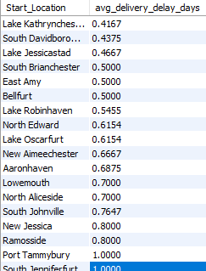
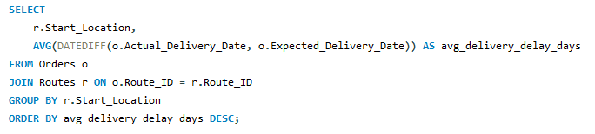
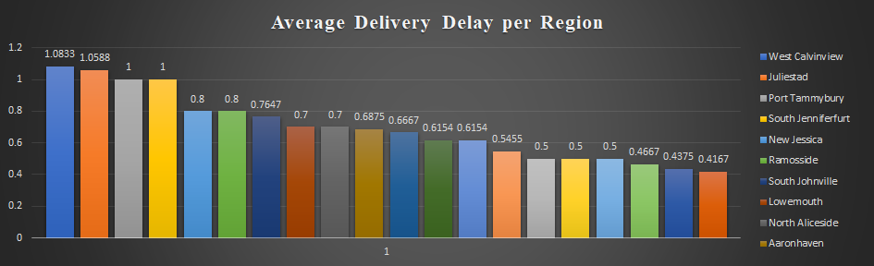
Average Delivery Delay per Region (Start_Location).

Slide 20
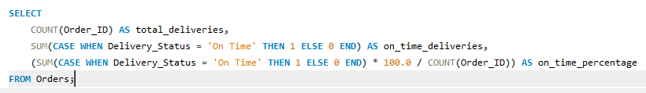

On-Time Delivery %

Slide 21
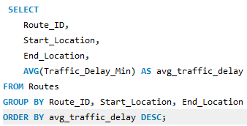
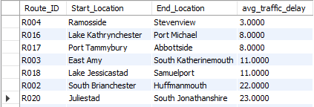
Average Traffic Delay per Route

Slide 22
Project Link :
Introduction
Timeline
Areas of growth
Summary
https://drive.google.com/file/d/1nZErB1DANml1fjPy9RQOTEXRKjN17Eg4/view?usp=sharing
Primary goals
Presentation Title

